Slide 1
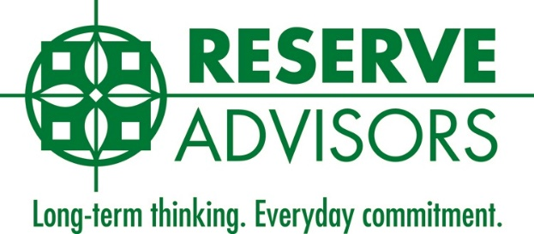
Aging Infrastructure: Budget and Insurance Implications
=
Notes:
Breaking Point: Aging Infrastructures
The Surfside tragedy has created a lot of attention around the need to plan for aging infrastructure. CAI's Foundation for Community Association Research (FCAR) identified the need for and lack of awareness around the subject in 2020. We discuss this very important and timely topic, what it means, and how it impacts community associations. 1. Proper planning: prepare an association to rethink how to budget for hidden infrastructure costs 2. Realistic Reserve Study scope of work and how to supplement it 3. Who has the obligation to pay for deferred maintenance and hidden damage

Slide 2
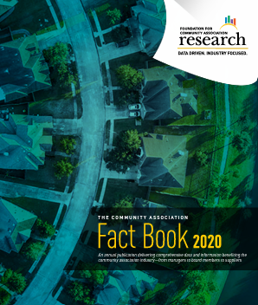
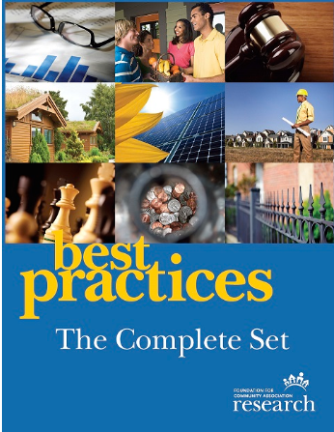
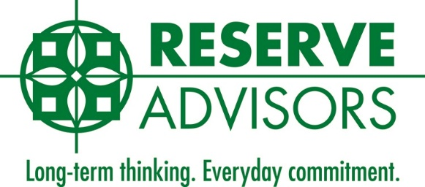
Mission: provide authoritative research and analysis on community association trends, issues, and operations. Our mission is to foster successful and sustainable communities.
Notes:
M

Slide 3
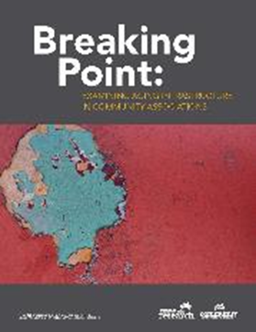
Breaking Point: Examining Aging Infrastructure In Community Associations Foundation for Community Association Research – Aging Infrastructure Task Force
FCAR Aging Infrastructures Research Outline :
2018 – Aging Infrastructure topic developed and Task Force formed with attorneys, reserve specialists, engineers, insurance providers, community association managers, and bankers
2018 & 2019 Research conducted with assistance of professional research company
2020 (May) Breaking Point research written and published by FCAR.
2020 – Present – webinars and presentation to chapters around the country.
2021, June 24 Champlain Tower South Collapse, Surfside, Florida
Notes:
M

Slide 4
Key Aging Infrastructure Research Findings
70% of survey respondents indicated that maintaining property values was their most import concern.
40% of those surveyed considered deteriorating infrastructure as a top-ranked concern.
81% of survey respondents reported encountering unanticipated and unplanned infrastructure problems over a recent three-year period.
80% of those surveyed felt it was critical that their association have adequate reserves in the event of a major infrastructure failure or construction need.
50% respondents felt their associations have adequate reserve funds on hand, just as many respondents considered their communities’ reserve funds inadequate to address any major unplanned component repair.
According to respondents, issues affecting elevators, termite infestation, and plumbing or electrical systems are attended to immediately. When possible, associations are inclined to postpone remediating problems in common areas or those related to original construction.
An association board’s attitude and perspective arguably are the most significant factors affecting how and when infrastructure damage, challenges and solutions is addressed.
Notes:
M

Slide 5
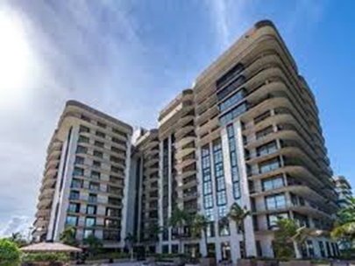
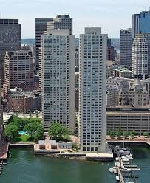
Can You “See” the Infrastructure Problems?
How will your managed association identify let alone pay for unseen infrastructure problems when they manifest?
Notes:
Michelle
They told me about fees and assessments.
They told me about funding reserves for wear and tear.
They told me about Insurance costs for unexpected perils.
No one told me about hidden infrastructure problems and potential costs!.

Slide 6
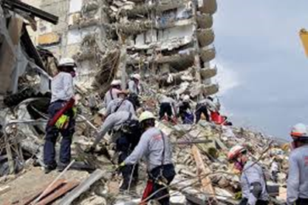
Product | Limit | Insurer
Property | $20MM | Great American
General Liability | $2MM | James River (non-admitted)
D&O | $1MM | Philadelphia
Umbrella | $15MM | 1st 10MM Allianz 2nd $5MM QBE
Total Limits | $38MM | This is the total of limits from Champlain Tower South Insurance Carriers
Class Action Third Party Settlement | $1 Billion | Settlement Breakdown is available upon request.
Notes:
Christa
Champlain Towers South’s Master Property Policy had a $30,172,900 building insurance limit. CoreLogic reports run in July 2021 ($44,162,108) and
January 2022 ($55,603,032) show that the building was underinsured (regardless of the fact that Florida is a bare walls state).
Great American Insurance Co. elected to tender the policy limit 22 days after the building’s collapse – prior to the conclusion of the investigation and a determination of the cause of the loss.
Great American also elected to pay the Property policy’s limit. Litigation costs to defend the various exclusions and limitations, as well as bad faith claims, could far have exceeded the Property policy’s limit of $30.1 million.

Slide 7
CAI’s Surfside Response: CIRMS Task Force
Where are we at today from the Insurance Perspective?
In the aftermath of the Surfside building collapse, Boards of Directors should be aware of the potential market and legislative changes that may affect future underwriting guidelines
Boards should consider the following risk management tools and property upgrades to better fulfill their fiduciary obligations and provide ease of underwriting, expanded options, and improved pricing stability for their association's insurance program.
Notes:
Christa
October 2021

Slide 8
CAI’s Surfside Response: CIRMS Task Force Findings
Risk Management Tools
Reserve Study (including roof replacement schedule)
Reserve Funding
Loss Control Inspections
Engineering Reports &/or Property Condition Assessment Reports (on aging mid-high-rise buildings)
Proactive Maintenance & Update Schedules
Water Detection Systems
Notes:
Christa

Slide 9
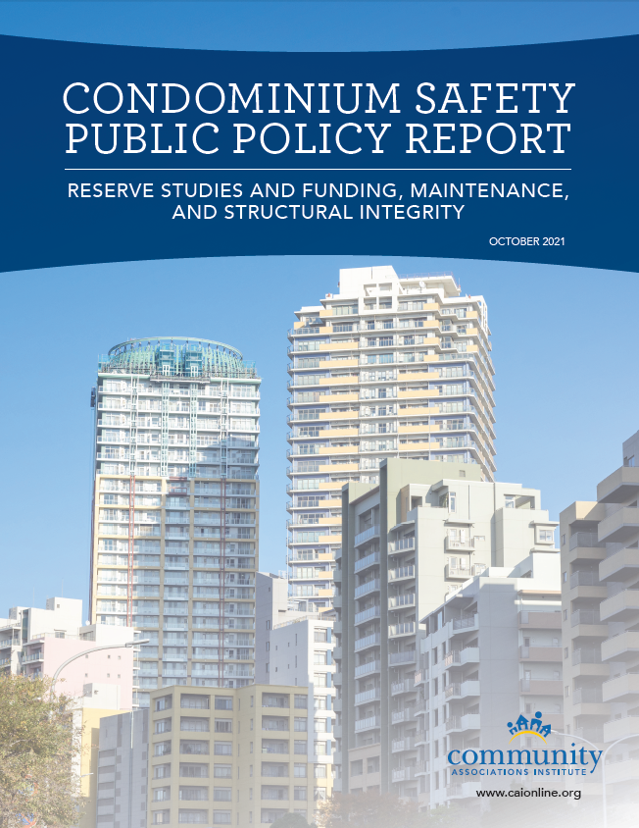
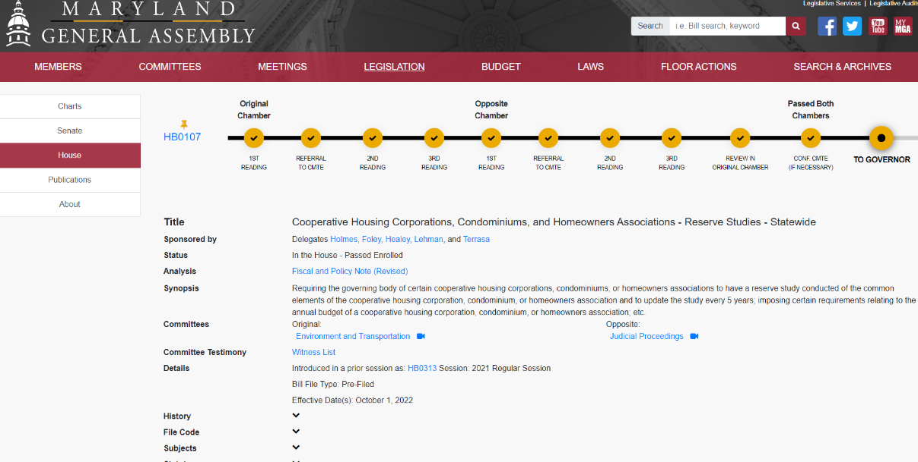
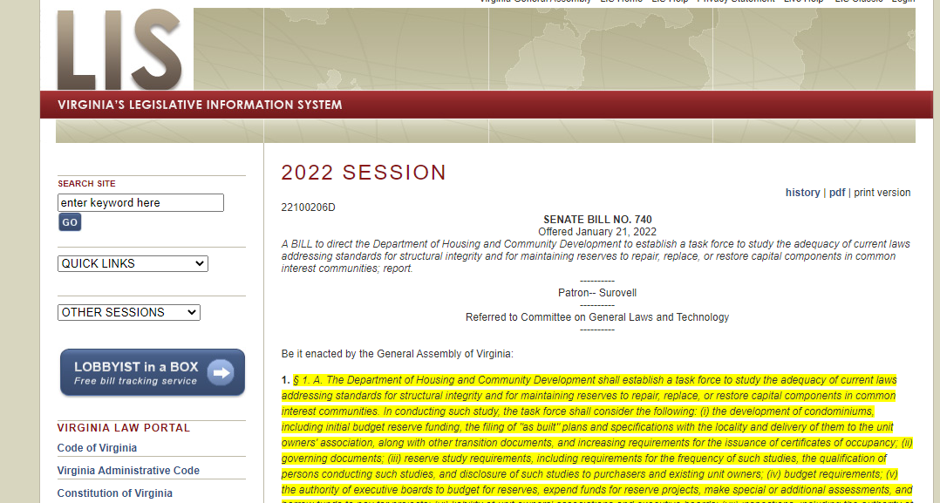
Where are we at today?
Notes:
M

Slide 10
What is a Reserve Study?
A budget planning tool which identifies the current status of the reserve fund and a stable and equitable funding plan to offset the anticipated future major common area expenditures. The reserve study consists of two parts: the physical analysis and the financial analysis.
Expenditures = Savings + Contributions
Notes:
M

Slide 11
A Capital Reserve Study is not the same thing as a Preventative Maintenance Plan
A Preventative Maintenance Plan is:
A budget planning tool that is used to aide community associations in setting aside funds for anticipated common element maintenance expenditures.
This should include identification, quantification and financial analysis of only the regular, scheduled activities that maintain the associations common elements.
Not all communities have a formal maintenance plan.
Notes:
M

Slide 12
Do reserve studies ensure we can avoid what happened at Surfside?
Our recommendations are based on a visual, non-invasive inspection of the community and from our prior experience of working with similar communities. It’s typical for us to include building repairs, such as concrete restoration and plaza deck replacement, when applicable. If we see areas of concern (spalling, settlement, water infiltration) we will document these areas and likely recommend further evaluation.

Slide 13
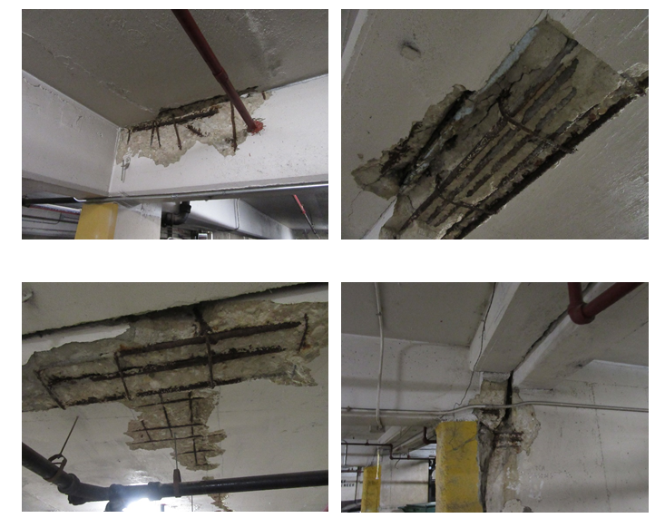

Slide 14
How do we ensure we are properly managing our property?
Realistic expectations of Reserve Study scope.
Don’t overlook Professional Consultants.
Make sure we account for these expenses in the budget.

Slide 15
1. Reserve Study Scope – Realistic Expectations
Boards expect the Reserve Study to identify all problems.
Reserve Studies are limited to visual and apparent conditions.
Reserve Studies should rely on input from other Specialized Experts to identify conditions of elements that can’t be visually inspected during the reserve study process.

Slide 16
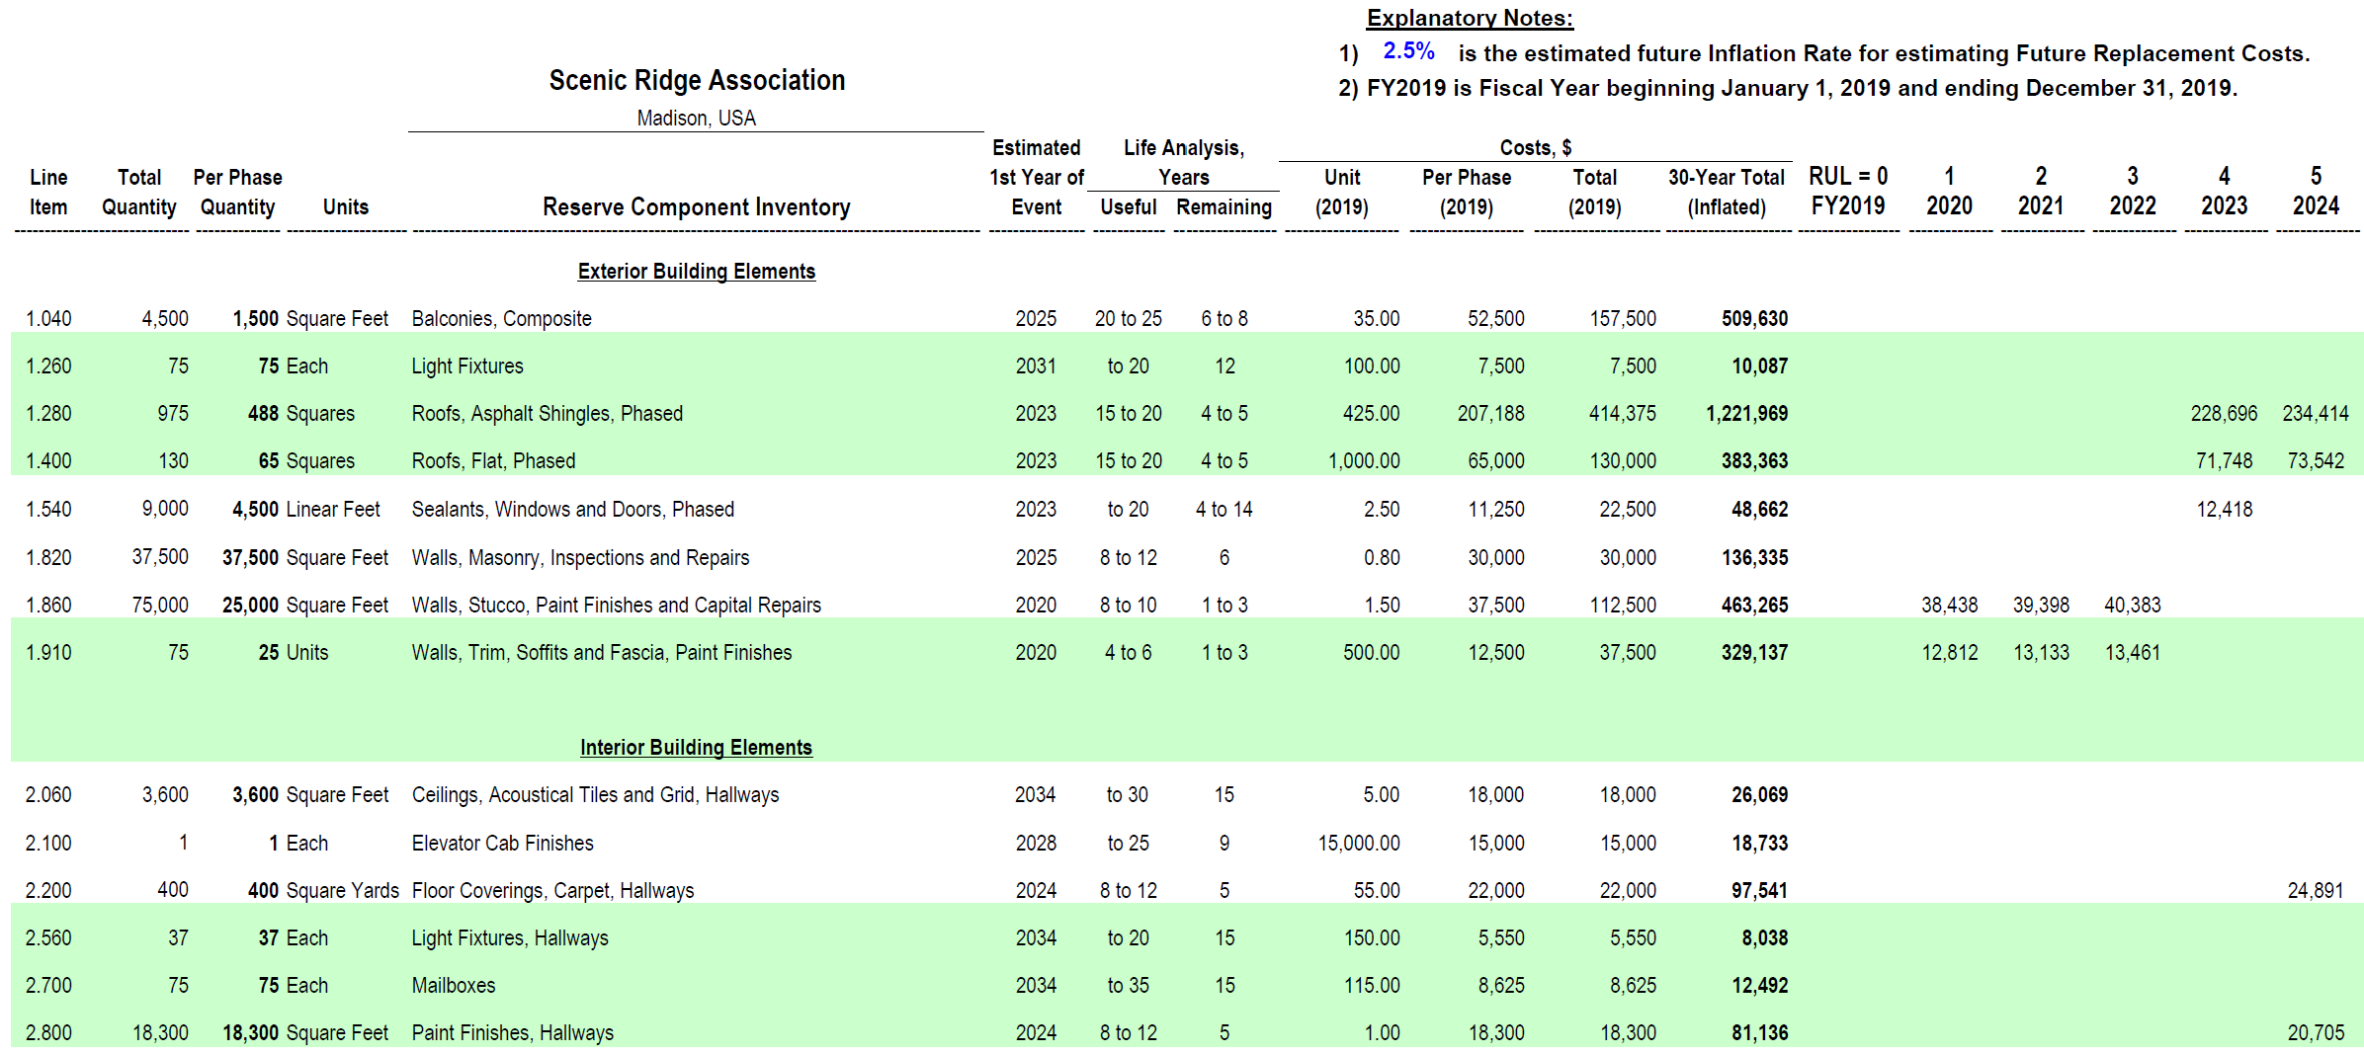

Slide 17
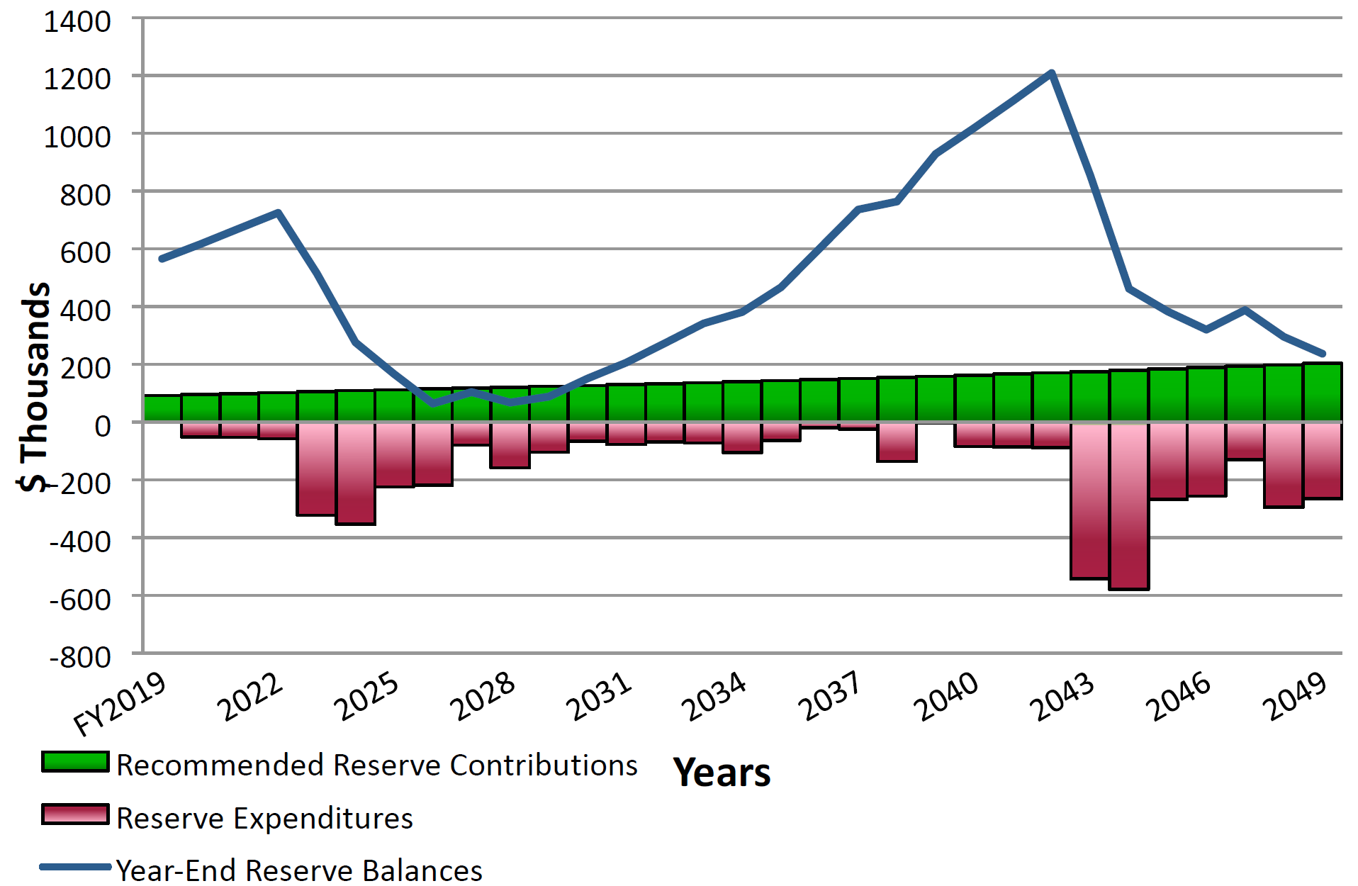
Notes:
M
30 minutes,

Slide 18
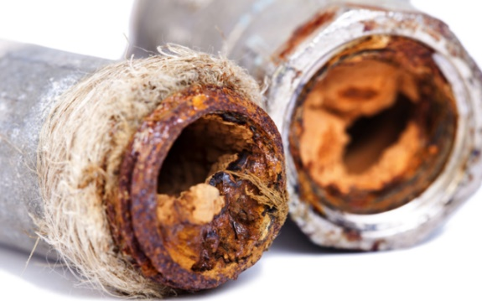
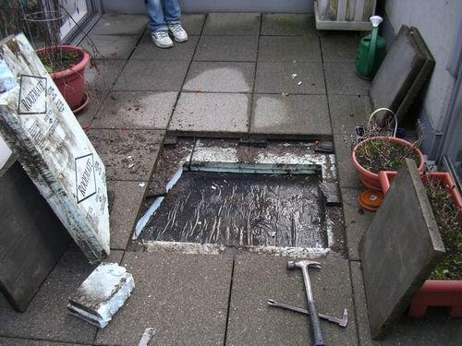
2. Don’t overlook Professional
Consultants
Conditions are not hidden, they are just not identified!
If they are not remediated, conditions can go from minor to bad to catastrophic!
Specialized experts should be brought in more frequently.

Slide 19
Professional Consultants Most Often Overlooked Until Associations Face a
Critical Issue
Architects
Structural Engineers
Building Envelope Specialists
Mechanical, Electrical, Plumbing (MEP) Engineers
Pond Specialists
Pavement Consultants
Arborists

Slide 20
Why are Professional Services Overlooked?
Many Boards feel that their Duty is to not spend money rather that to spend money prudently!
Some Boards expect the Manager to know all the answers!

Slide 21
Why are Professional Consultants Necessary?
Detect “hidden” conditions
Identification of critical issues, safety hazards and potential failures
Understand specific budgeting needs for maintenance
Validate best maintenance practices

Slide 22
3. Account For These Expenses in the Budget
Many communities think of two budget categories:
Operations & Maintenance
Replacement Reserves

Slide 23
We should think in terms of three
different Budget categories:
Each has its own purpose!
Operating Expenses
Replacement Reserves
Maintenance Expenses

Slide 24
Operations budget examples:
Operational Expenses
Insurance, Utilities, Taxes
Management Expenses
Professional Management, Employee/Staff Payroll
Professional Consultant Expenses
Attorney, Accountant, Reserve Specialist, Arborist, Structural Evaluation, Pipe Study, Pond Specialist
Notes:
Michelle

Slide 25
Maintenance budget examples:
Service Contracts
Pool Equipment, HVAC, Elevators
Annual Services
Pool Maintenance, Landscaping
Building Services
Minor Equipment Repairs

Slide 26
Replacement Reserve Budget:
Funding for any and all “Replacement and Major Repair” projects.
General Rule of Thumb:
1% of the operating budget as the reserve cutoff.

Slide 27
Best Practices: How are insurance companies underwriting in today’s market?
Soft Market vs Hard Market
Increase in Property values (TIV), crime scores, roof ACV
Deductible Structure (per unit, water damage, $100K, %)
Strict underwriting guidelines: age 20+, electrical (Aluminum Wiring, FPE), plumbing, rental occupancy
Loss Control Recommendations
Water detection systems (proactive maintenance)
Notes:
Christa
Exclusions and Limitations (ACV roof) Depreciation
Federal Pacific Electrical panels
Breaking Point: Aging Infrastructures
The Surfside tragedy has created a lot of attention around the need to plan for aging infrastructure. CAI's Foundation for Community Association Research (FCAR) identified the need for and lack of awareness around the subject in 2020. We discuss this very important and timely topic, what it means, and how it impacts community associations. 1. Proper planning: prepare an association to rethink how to budget for hidden infrastructure costs 2. Realistic Reserve Study scope of work and how to supplement it 3. Who has the obligation to pay for deferred maintenance and hidden damage

Slide 28
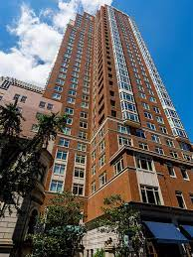
Property values
2019
2022
$220 Million RC
$193,000 Prop Premium
$260 Million RC (18%)
$230,000 Prop Premium (19%)

Slide 29
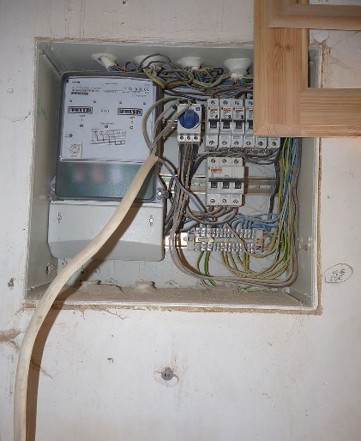
MD Condo Case Study
Deferred Maintenance
Built in 1963
MNC Construction
375 units
6-story mid-rise
10% sprinklered
No property losses over 5-years
Building Value $71,511,522 Million
9/1/2021
Expiring premium $90,000
Deductible $10K
Incumbent carrier non-renewed
This Photo by Unknown Author is licensed under CC BY-SA

Slide 30
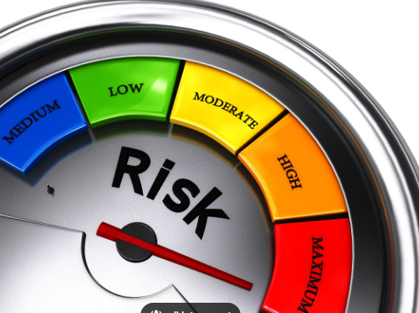
2022 Premium indications starting at $198,000!

Slide 31
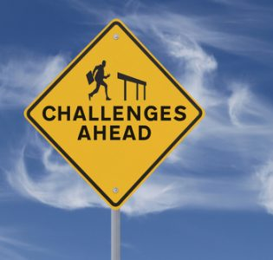
Underwriting Challenges
Age of building
10% sprinklered – 6 floors
Lack of Upgrades
- electrical fuses
- plumbing
- roof

Slide 32
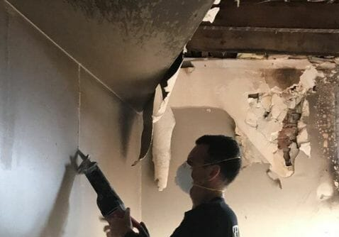
Result of Weak Underwriting Profile
due to Deferred Maintenance?
- Carrier may exclude, resulting in denied claims
- Financial impact: Pay out of pocket
- Increased claims
- Financial impact: Renewal Increase (5 years) or Non-renewal
-Higher deductible
- Long Mandatory Loss Control Rec’s
- Financial Impact: Special assessment or obtain a loan
- No alternative carriers willing to make an offer
- Financial Impact: No leverage for competitive bids
1
2
3
4

Slide 33
Best Practices
Communicate with your insurance broker during the budget process (market updates, underwriting trends, 5-year loss performance, carrier’s feedback).
Don’t overlook professional consultants: RS, CIRMS, CCAL, PCAM, CMCA. Invite them to participate in board meetings.
When budgeting make sure you are including all categories: Operations, Maintenance, and Reserves.
Budget for periodic in-depth assessments/studies.
Notes:
TAKEAWAYS
Christa: 1&2
Michelle: 3&4

