Slide 1
EJF Board Learning Series – February 16, 2023
DC Collections Best Practices
& Remedies
Legal and Non-Legal
Presenters:
Brad M. Barna & Dan D. Blom
Chadwick, Washington, Moriarty, Elmore & Bunn, P.C.

Slide 2
We are lawyers, so . . .here you go . . .
Legal Disclaimer
This information is not intended to be legal advice. Legal advice must be tailored to the specific facts and circumstances of each case and each association’s governing documents.
Every effort has been made to ensure this information is up‐to‐date. However, it is not intended to be a full and exhaustive explanation of the law in any area, nor should it be used to replace the individualized advice of your legal counsel.

Slide 3
Sustainability of operation and management of financial affairs
Upkeep of structures and facilities
Provision of services
Landscaping
Trash collection
Snow removal, etc.
Importance of Assessments

Slide 4
Effect of Delinquencies
Budget Deficiencies
Reduction in community-supplied services
Additional burden to
paying members
– higher fees
– special assessments
General negative impact on property values and community as a whole
Banks less willing to lend to purchasers/refi

Slide 5
Sources for an Association’s Assessment Collection Authority
DC Law
Declaration of Covenants
Bylaws
Rules and Regulations

Slide 6
Administrative Collections Remedies
Suspensions of voting rights/right to serve on the Board
DC Code authorizes suspension of voting rights for 30 days’ delinquency, but right to serve is based on documents
Suspension of right to use facilities and services (parking, pool passes, etc.)
Board may adopt reasonable rules
regarding member rights to use these areas
& services, subject to limitations provided
in the governing documents.
Notice? Cure period? Hearing?
Resale Disclosure Package/Certificate – paid at closing
DC Housing Assistance Fund – https://haf.dc.gov/

Slide 7
Legal Collections Remedies
Referral to Legal Counsel for Collection
Information checklist (what does counsel need?)
Timing – be aware of deadlines (3 years)
Has notice of intent to take legal action with the language required under DC Code Section 42-1903.12a been sent?

Slide 8
Turnover to Counsel
What does counsel need?
Documentation of Association’s name
Last account number (if any)
Copy of Association’s governing documents, e.g., Declaration, Bylaws, Collections Resolution, etc.
An itemized accounting of the amount claimed to be owed, including the amount of the principal, any interest, fees, or charges, back to a zero balance.
Copies of correspondence with debtor, including the notice of intent to take legal action with the language required under DC Code Section 42-1903.12a

Slide 9
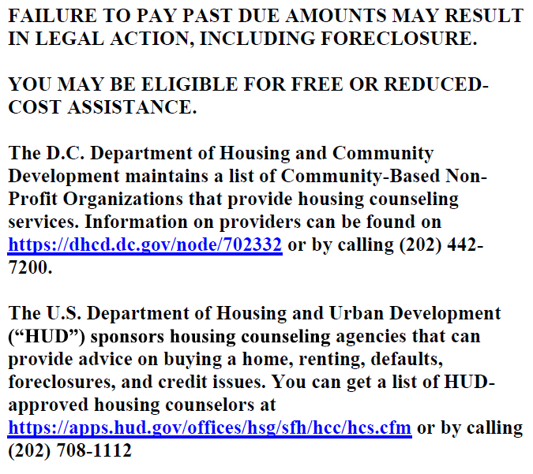

Slide 10
Securing Debt: Assessment Liens
Importance of Liens
Secure Debt Against the Lot/Unit
Can trigger payment when Lot/Unit is sold or refinanced
Lien priority – timing of lien puts Association in line to be paid
DC has automatic lien and “superlien” for most recent 6 months of condo assessments
Survives bankruptcy (generally) and can make association secured creditor in Chapter 13 (payment plan) bankruptcy case
May be foreclosed on by Association
Deadlines
DC Condominiums – Condominium Act, Sec. 42-1903.13 – liens may be enforced back for 3 years (not counting March 11, 2020 to September 30, 2022 due to COVID restrictions)

Slide 11
Assessment Collection Process – District of Columbia
Debtor Account Referred to Counsel
Ownership/unit title verified; bankruptcy records searched; confirm accounting
FDCPA Validation Notice
(giving 30 days to dispute before additional legal action)
Lien Warning Letter
(giving 10 days to pay before filing lien)
Assessment Lien prepared, signed by President and filed with the DC Recorder of Deeds (if owner does not pay)
Military status confirmed; lawsuit affidavit prepared and signed by President
(See next page for court procedures)

Slide 12
Filing Suit
Formal proceeding filed in court of law
Typically filed in DC Small Claims Division, but that has a $10k limit; DC Superior Court for amounts over $10k
Goal: to obtain a monetary judgment that gives association right to garnish/attach assets
Collection of Attorneys’ Fees?
Declaration/Bylaws
Statutory Authority
Condo Act
Potentially now limited to 15%
Judgment survives foreclosure

Slide 13
Small Claims Court
(Principal Balance is $10K or Less)
Superior Court
(Principal Balance is $10K or more)
Service of Process: (i) Personally or Substituted (using a PPS who notes GPS location) or (ii) Certified Mail but must have legible signature of a Defendant;
Initial Hearing
Scheduling Conference
Defendant appears
Defendant does NOT
appear
Motion for Default (only if the Court is satisfied with service)
No Answer Filed – Motion for Default (if the court is satisfied with service)
Mediation (mandatory)
Answer filed, case set for discovery, mediation, and trial
Stipulated Agreement
Trial (if parties cannot reach a settlement)
Ex Parte Proof Hearing
Trial
Monetary Judgment

Slide 14
Post-Judgment Collections
Garnishments aka Writ of Attachment
Wage Garnishment
Used to have employer
turn over wages of debtor
Bank Account Garnishment
Used to have bank turn over money of debtor
Rent Garnishment
Used to have tenant turnover rent payments to judgment creditor (Association)
Debtor Interrogatories - question debtor on assets; debtor may be compelled under threat of contempt

Slide 15
Assessment Collection (after judgment awarded)
MONEY JUDGMENT AWARDED
POST JUDGMENT COLLECTION ACTIVITY
(to actually recover funds)
Wage Garnishment (Writ of Attachment)
(requires debtor’s employer to withhold portion of paycheck and send to creditor until the judgment is satisfied)
Bank Garnishment (bank required to freeze debtor account – condemnation order obtained and sent to the bank - $$ sent to creditor after order)
Rent Garnishment (tenant ordered to withhold rent payments , condemnation order obtained, $$ sent to creditor after order
Oral Exam (Interrogatories)
(debtor must come to court to testify under oath to attorney regarding all debtor’s assets and income) – info used to file wage, bank or rent garnishments
Note:
Garnishments require that counsel have information regarding debtor’s employer, bank or tenant. Sometimes we recommend private investigator asset searches to determine this information (if we or client do not already have it)
Note:
We usually resort to Interrogatories only if we do not have banking, job, or tenant information for a garnishment, since you lose the element of surprise by getting this information directly from debtor

Slide 16
Foreclosure
DC Foreclosure law is in a state of flux due to recent decisions by the DC Court of Appeals and changes in Condo Act (2017)
Can foreclose on “superlien” for most-recent 6 months of assessments, not subject to other liens, or for all amounts owed, but subject to senior liens, e.g., first deed of trust
Judicial or Non-judicial –
Non-judicial typically done in very limited circumstances due to clash of Federal/state laws regarding debt collectors
Judicial requires a full lawsuit in DC Superior Court against owner and all lienholders to obtain Order of Sale
Can be very costly for association – recommended for higher balances only
Not all properties are good candidate for foreclosure
How much equity? Other liens?
Title problems
Marketability of lot/unit?

Slide 17
Collection Best Practices: Top 5 Tips
Adopt Collections Resolution AND FOLLOW IT
Provide for order of payment application, acceleration, etc.
Keep Accurate and Timely Accounting Records
You’re with EJF, so you’re all good here!
Be Reasonable and Practical on Payment Plans
Money coming in is a good thing!
Don’t Try to Collect Outside of Authority
Courts frown upon this, and for good reason.
Communicate Early and Often with Debtors
Debtors should be well aware of their account balance before being turned over to legal.

Slide 18
Questions?

