Slide 1
EJF Real Estate
10 STEPS
TO UNDERSTANDING THE
MONTHLY FINANCIAL REPORT

Slide 2
NCB OPERATING
ACCOUNT
CASH BALANCE
Is the cash balance of the NCB operating account equal to 10%-20% of the total annual assessment (15% or more is the goal)?

Slide 3
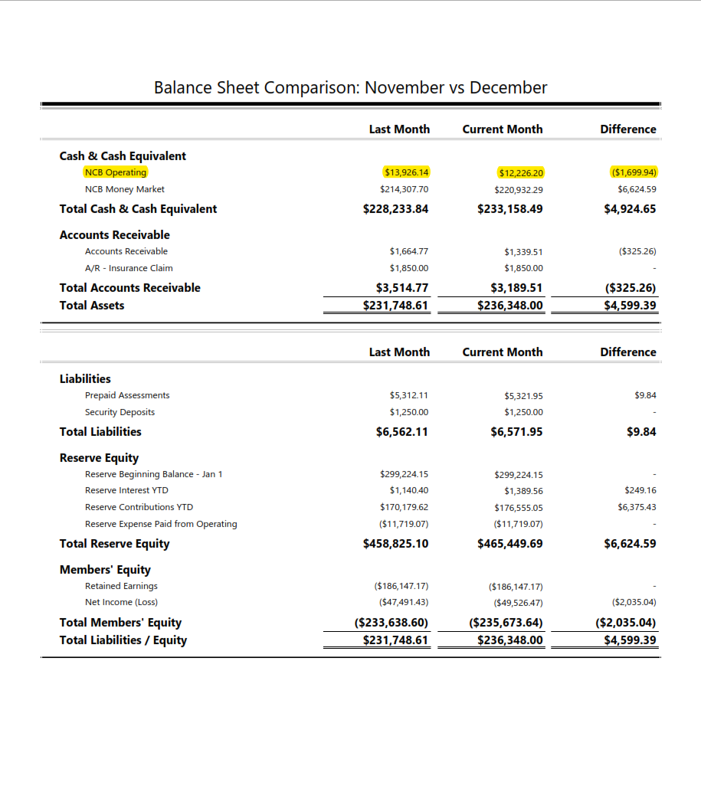
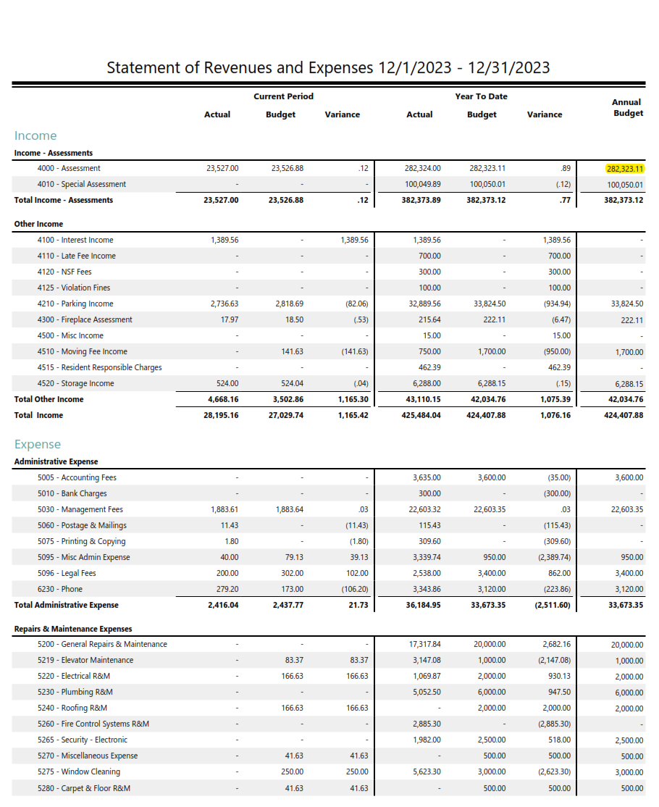

Slide 4
MONTHLY RESERVE
CONTRIBUTION EXECUTED?
In the “Difference” column,” does the NCB reserve cash account display the monthly reserve contribution transfer?
If not, were capital expenses paid in the month?

Slide 5
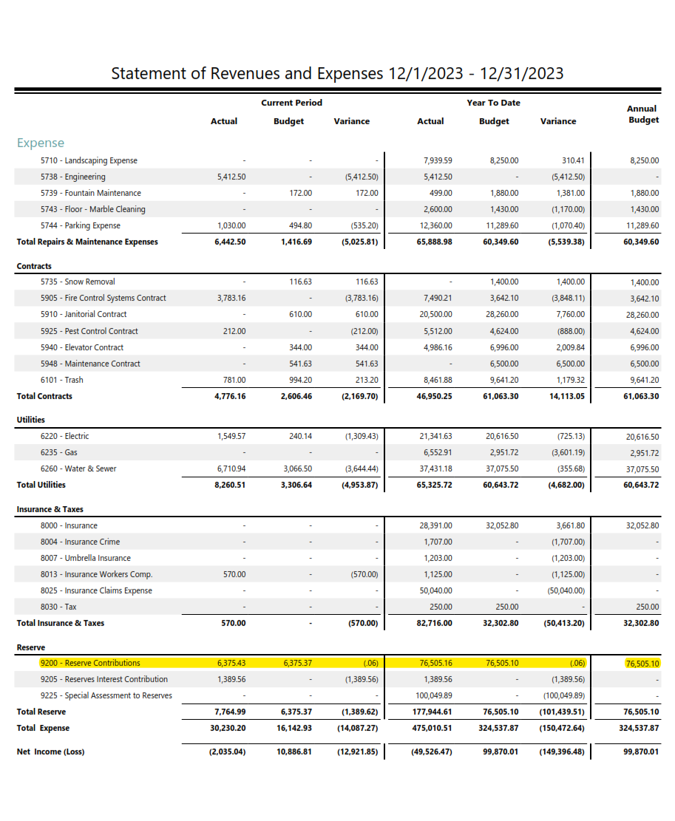
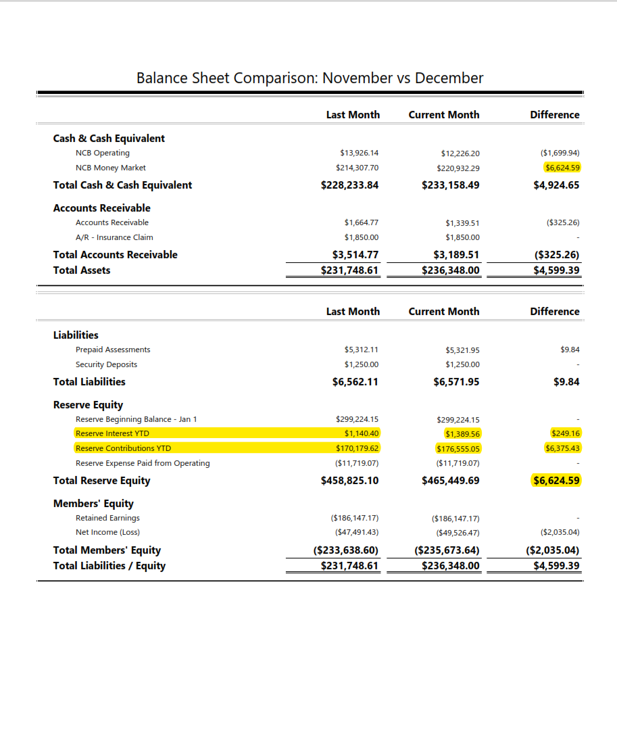

Slide 6
ACCOUNTS RECEIVABLE
Did the balance increase or decrease?
Review and determine if Board action required on delinquent accounts.
Review legal team report.

Slide 7
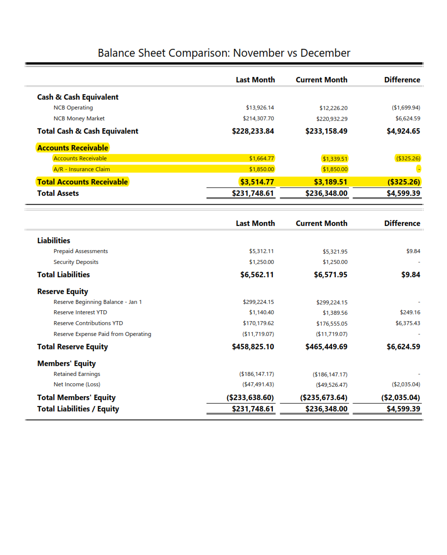
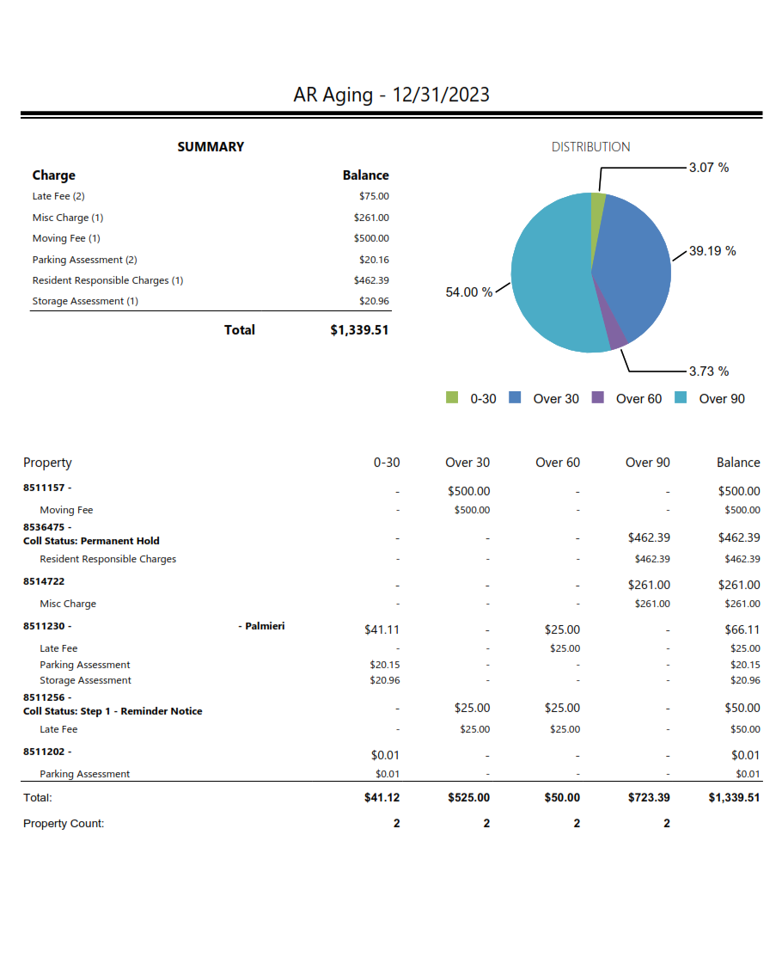

Slide 8
RESERVE
EQUITY
In the Reserve Equity section were the reserve transactions posted?
Is the reserve cash fund balance (total of all reserve accounts) at least 80% of the Reserve Study recommendation?

Slide 9
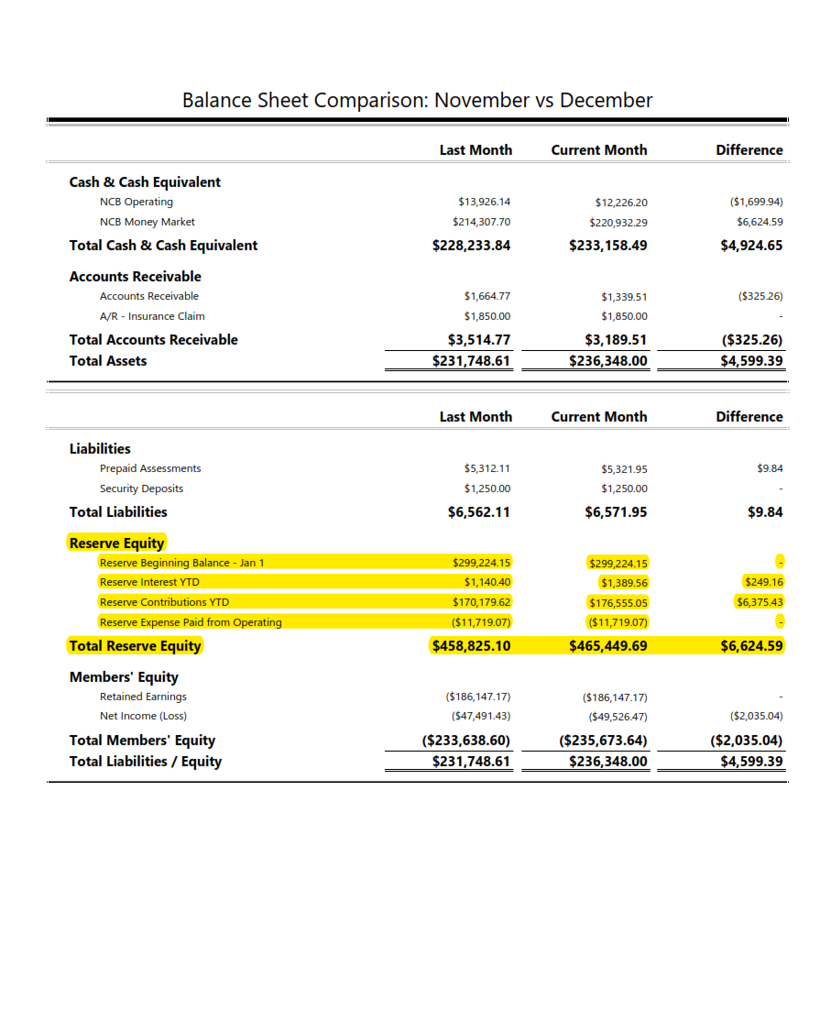

Slide 10
OWNERS
EQUITY
Is Retained earning positive or negative?
Is Net Income positive or negative?
Is total Members equity between 10%-20% of annual assessments (15% or more is goal)

Slide 11
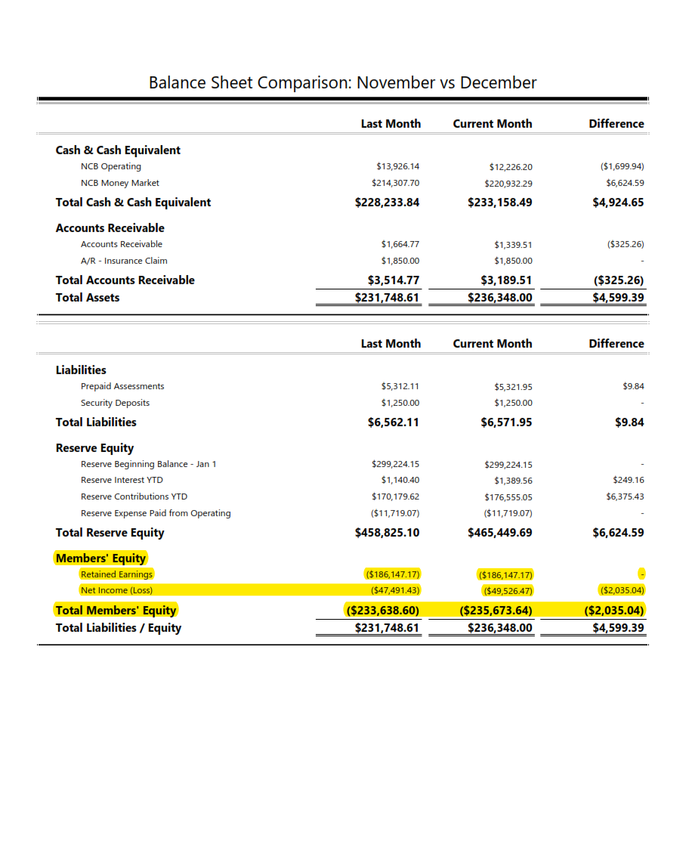

Slide 12
STATEMENT
OF REVENUE
& EXPENSES
Review the monthly and YTD numbers. Pay attention to the Year-to-Date columns; these are often more useful. Focus on variances greater than 10%.
Review Summary Statement of Revenue and Expenses for gaps, trends, or missing information.

Slide 13
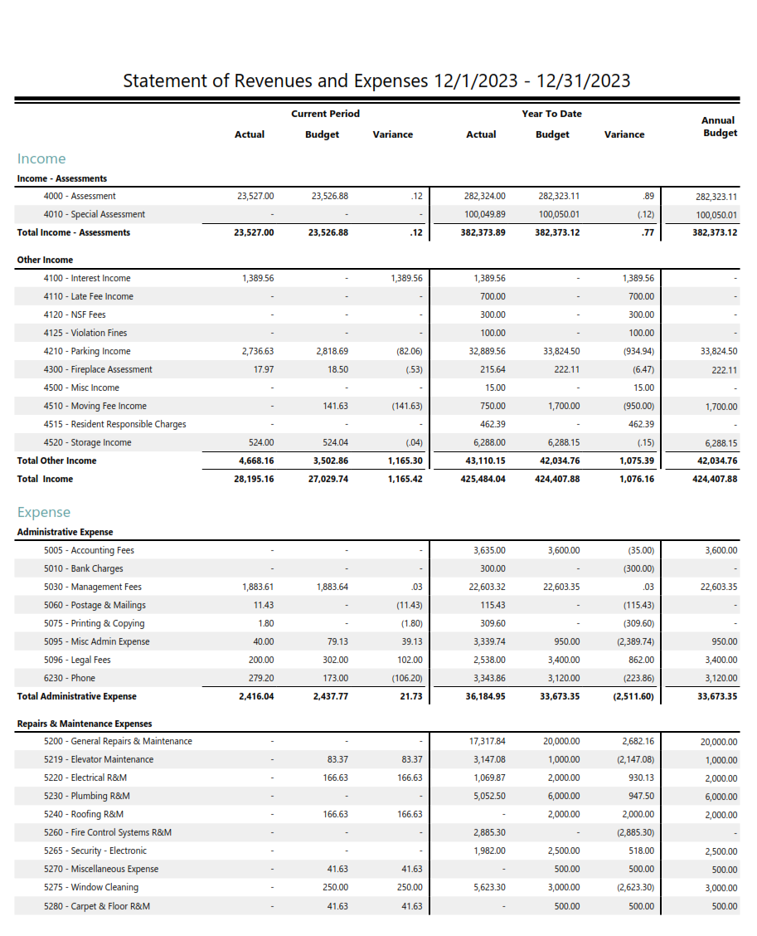

Slide 14
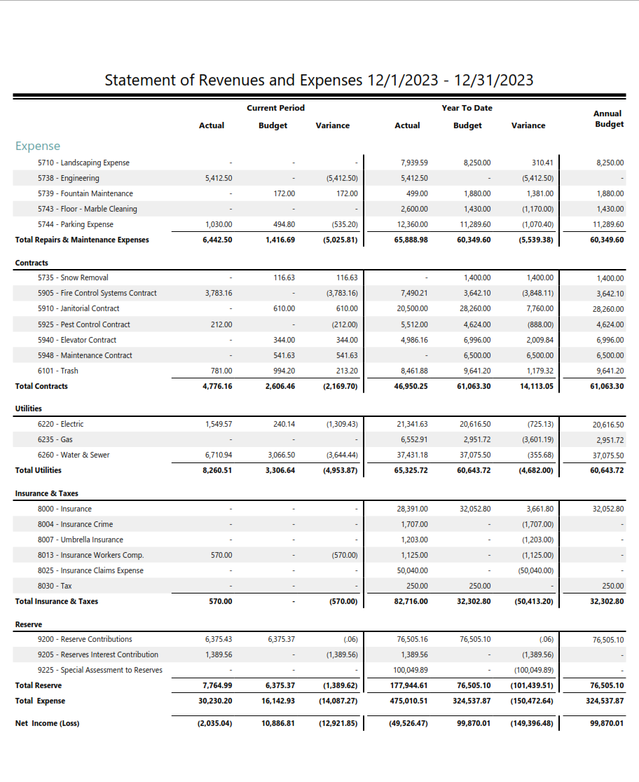

Slide 15
GENERAL LEDGER
The general ledger provides detail about every account. First bulk of pages are balance sheet items and confusing for non-accountants. Focus on the expense legers for names, amounts, and descriptions of expense payments.

Slide 16
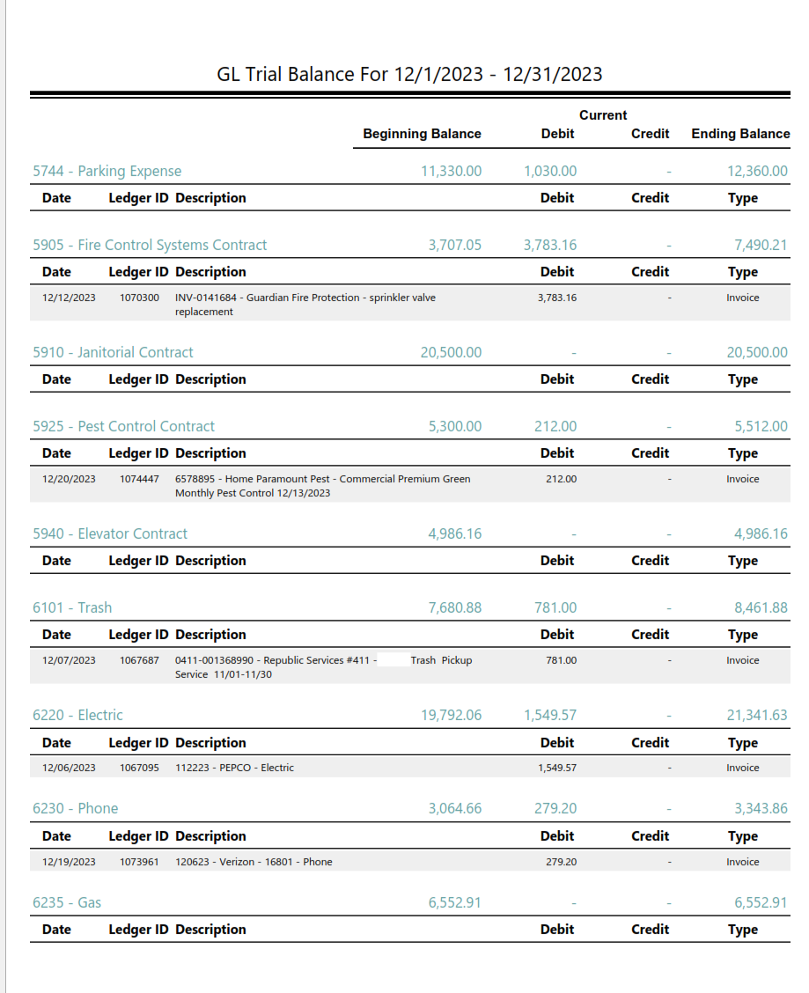

Slide 17
BANK
RECONCILIATION
REPORT
Check the for accounts with missing statements (labeled as “Out-of-Balance"). Missing bank statements means incomplete financial data.
Review uncashed checks or deposits over 60 days. Should be addressing these situations.

Slide 18
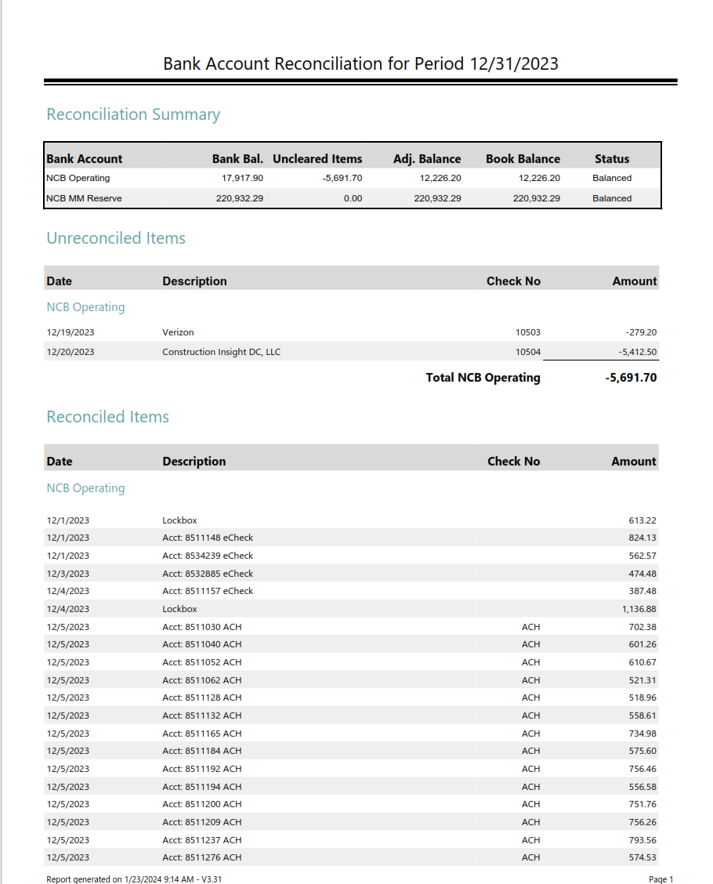

Slide 19
BANK
STATEMENTS
Look at checks and names of vendors.
Review for any anomalies.

Slide 20
INVESTMENT
ACCOUNTS
Review for upcoming maturity dates, cash balances (should not be too large), interest rates (especially on MM accounts), and types of investments.

